Slide 1
Web Service Recommendation
Presented by Group 4
Dibyanshu Chatterjee
Atharva Lele
Sreenivas Reddy S

Slide 2
Web Service Recommendation
A recommendation for a web service extends the idea of recommending the most suitable web service to be used by a user, based on specific and selective features
The user's preferences, usage patterns, and other pertinent information can all be used to establish the recommendation
Uses techniques from machine learning, data mining, and information retrieval to analyze user behavior and preferences
Web service recommendation can be useful in a variety of contexts, such as e-commerce, social networking, and healthcare
Notes:
A recommendation for a web service is a proposal or piece of advise given to a user regarding a specific web service or application that can satisfy their unique needs. The user's preferences, usage patterns, and other pertinent information can all be used to establish the recommendation.

Slide 3
Survey Papers
The three papers referred for application of Web Service Recommendation are:
Deep Collaborative Filtering-based Approach for Context-aware IoT Service Recommendation.
Location-Aware Feature Interaction Learning for Web Service Recommendation.
Incorporating User, Topic, and Service Related Latent Factors into Web Service Recommendation

Slide 4
Introduction
Deep Collaborative Filtering-based Approach for Context-aware IoT Service Recommendation
This approach uses deep collaborative filtering techniques to recommend Internet of Things (IoT) services to users, taking into account contextual factors such as time and location.
Location-Aware Feature Interaction Learning for Web Service Recommendation:
Web services encapsulate application functionality and make themselves reachable via defined interfaces, enabling interoperable machine-to-machine communications via networks. This body of work sheds light on using Web services as fundamental software building blocks in service computing.
Incorporating User, Topic, and Service Related Latent Factors into Web Service Recommendation:
This approach focuses on utilizing machine learning approaches to recommend online services to consumers, based on both past usage statistics and service descriptions, in order to get beyond the problems associated with CF-based service recommendation strategies.

Slide 5
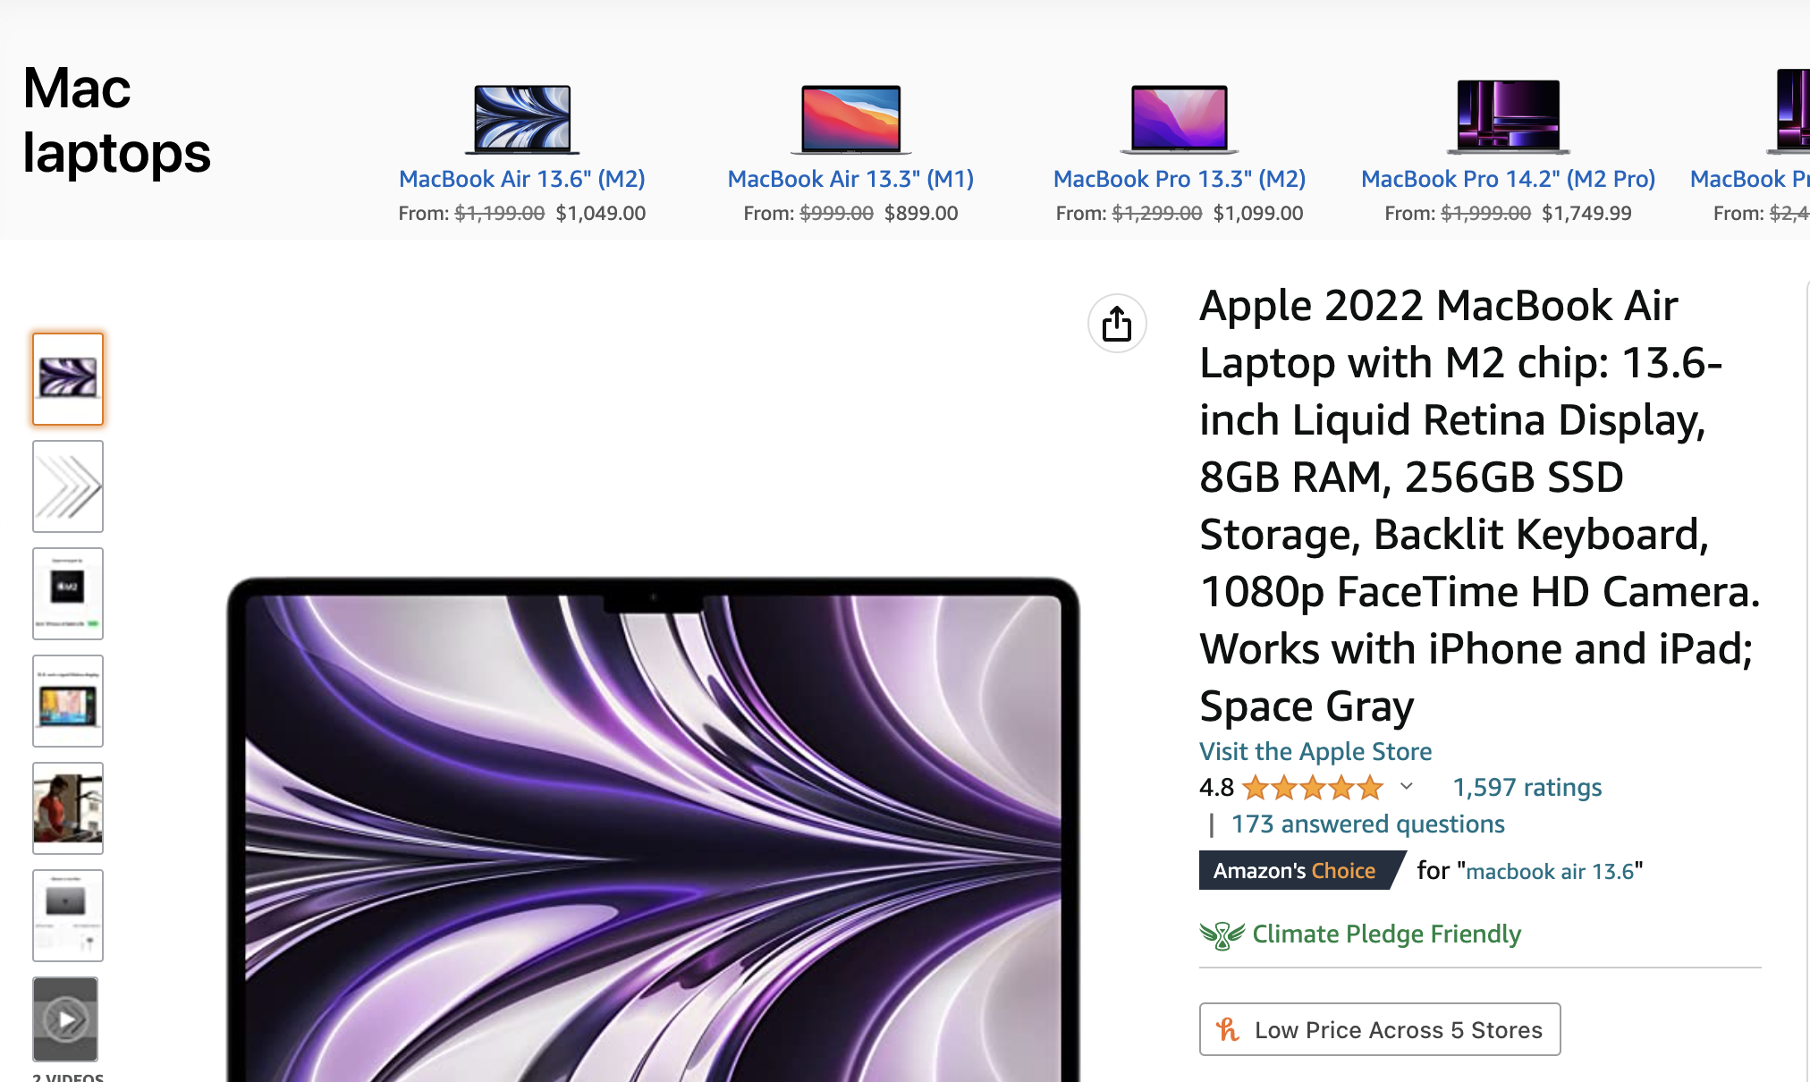
Incorporating User, Topic, and Service Related Latent Factors into Web Service Recommendation:
Background
Web services are more flexible and convenient way in delivering business, Customer interaction and exchange of data over the web.
As a result, during the past ten years, both the number of online services and the size of their user bases have rapidly risen.
This drives service recommendations to actively advise interesting web services to users, facilitating service discovery and better user experience.
Ex:- Macbook Search
Notes:
Ex:- I was looking for a new Mac book, I went to amazon/ best buy websites and I searched for MacBook Air, in the results I got all the products that are related to it. Which is very good and effective in promoting products and attracting customers.
Here, the related objects which we are getting from it is through web service recommendations.
recommending related products to customer by e-commerce companies, such as Amazon, which have been demonstrated to be very effective in promoting products and improving customers’

Slide 6
Incorporating User, Topic, and Service Related Latent Factors into Web Service Recommendation:
Motivation
QoS-based recommendation methods use historical usage data to predict user preferences for services.
Collaborative filtering is a commonly used technique in QoS-based recommendation, which relies on inter-user and service similarity.
Whereas the main focus is on incorporating user preferences, functional and non-functional aspects of services, and latent variables in a graphical model for recommendation.
The proposed approach combines PMF and TM with user-related, service-related, and topic-related latent variables.
The model also takes both structured and unstructured textual descriptions of web services, along with historical usage data.
Notes:
We have many approaches based on functional aspects, non-functional aspects, clustering algorithms, CF and neighborhood methods for web service recommendation.
Matrix factorization: Users and services as a latent vectors in low-dimensional space with dimension K. Their dot product gives users experience of using a service.
Collaborative Filtering :- it performs well in analyzing the historical usage data and delivering a recommendation. This approach doesn’t consider service functionality. Hence its more suitable for QoS-based recommendation, but not functionality-based one.
The main focus of this paper is the combination of both service functional descriptions + historical usage data when learning a recommendation model.
The most ideal method for QoS-based recommendation is collaborative filtering, which leverages historical usage data to forecast user preferences. It utilizes PCC to determine inter-user and service similarity (Pearson Correlation Coefficient). Matrix factorization and decision tree learning have been used in some studies in an effort to predict client preferences for services in order to provide service suggestions. Prior to this study, the majority of service recommendations are concentrated on non-functional features of web services. Contrarily, the focus of this research is on user preferences as well as functional and non-functional aspects.
In some approaches collaborative filtering (CF) and content-based recommendation are combined. with CF, predict user ratings based on other similar users and content-based focusing on semantic similarity. However, in this research, PMF and TF are combined with a thorough graphical model that incorporates user-related, service-related, and topic-related latent variables.
User tags and service descriptions are integrated in LDA-based techniques. These methods identify pertinent services based on structural and functional service descriptions, but they missed to take latent characteristics into account. Where as in this paper comprehensive latent factor models, free text descriptions and historical usage of data are considered and used.

Slide 7
Methodology
Precisely, this model is a combination of probabilistic matrix factorization and probabilistic topic modeling.
Probabilistic matrix factorization: It handles user-related and service-related latent factors in the recommendation process.
Probabilistic topic modeling: It handles topic-related latent factors in the recommendation process.
To achieve high recommendation accuracy, latent factor models that comprises of user-related, service-related, and topic-related latent variables are used.
Notes:
The approach here is to model service recommendation as a prediction problem.
The model here, iis the combination of (both service functional descriptions + historical usage data) when learning a recommendation model. => probabilistic matrix factorization + probabilistic topic modeling, which means incorporating the knowledge of topic modeling into matrix factorization for service recommendation.
probabilistic matrix factorization : to capture both user-related and service-related latent F
probabilistic topic modeling : to capture topic-related latent factors.
Ex;- A service that posts the movie times and driving directions to selected theaters provides both entertainment and map functionality.

Slide 8
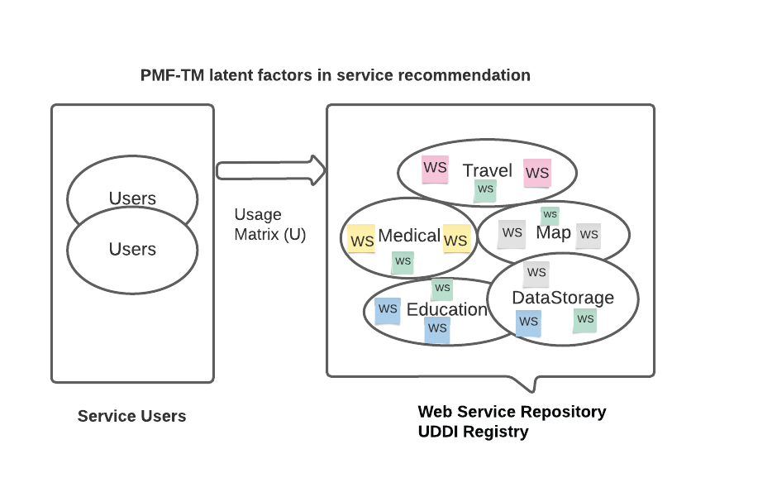
Methodology
PMF - TM Latent factors - Topic, Service, User related factors
Notes:
A collection of web services in a web service repository or a UDDI service registry or programmable web that resides different web services. Each web service is linked to a specific theme or subject.
A service might also be related to several other topics. For instance, a service that lists the closest hospitals and pharmacies together with driving instructions offers both medical and navigation functionalities.

Slide 9
Methodology
A collection of web services in a web service repository or a UDDI service registry or programmable web that resides different web services.
Each service may be related to multiple topics. For instance, a service that lists the closest hospitals and pharmacies together with driving instructions offers both medical and navigation functionalities.
Users choose services from the repository based on three decision-making factors: topic, service-related factors and user-related factors.
Topics are crucial in determining the functionality of a service, while service-related factors are less directly related to functionality
User-related factors are associated with user preferences and also influence service selection
Notes:
Services are chosen by users from a repository.
There are three factors that affects users to make a selection:
Topic related : These are related to service functionality. (Crucial element in figuring out).
Service related: not related to the service functionality of a service, but users may consider when selecting a service (ex:- availability, reliability, security level & non-functional features like JSON, XML etc..).
User related: Associated with user preferences (ex:-background, experience, consideration).

Slide 10
IMPLEMENTATION
Service by user usage matrix (U).
U(i, j) : it is i’th user’s interest in j’th Service.
Topic modeling method : LDA(Latent Dirichlet Allocation)
LDA Considers every service description is associated with multiple latent topics.
Ex:- Google Maps.
Notes:
Service By User Usage matrix(U) - each Row rep User, each Col Rep Service U(I,j) -> its user’s interest in J’th service.
The prediction is based on the user usage history records and the list of services used by a user. The terms in a service description can be used to learn the latent topic models.
Topic Modeling: These are mainly used as text mining methods to identify latent factors.
Latent Dirichlet Allocation (LDA) : Widely used topic modeling method.
It considers each topic as a probabilistic distribution and each document as a mixture of multiple topics.
Using LDA, every service description S(i) is associated with multiple latent topics.
Ex:- Google Maps service description associated with mapping, traffic, and viewer. (The distribution of topics are represented by Theta).
Alpha is Dirichlet parameter that defines topic proportion of a service description, by default every topic have same Alpha values. If we want, based on the prior knowledge we can assign higher alpha values to the topic.
Beta(K) -it defines the term distribution in the topic, represents the Kth Topic
Two service-level parameters, θ and s, where θ represents the topic proportion and s represents service-related latent vector determined by θ and λ which is a precision parameter.
On the service- level, r is a variable that represents whether a user is interested in the service, which is determined by a user-level parameter, u.(user related latent vector). It is also determined by λu, which is a precision parameter for users.
Here r and o are observable from historical usage data and service descriptions,

Slide 11
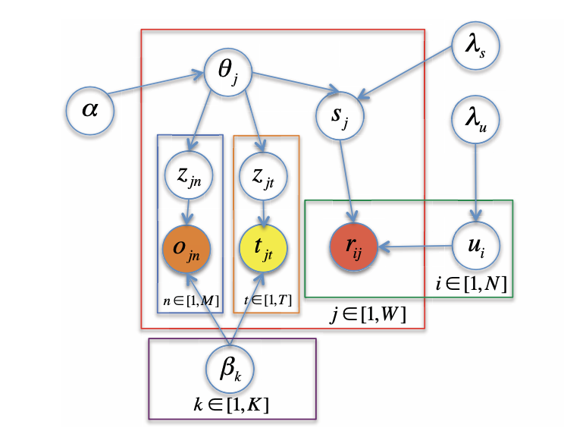
Graphical Model
Service : combination of topic proportion and latent offset.
Given two precision parameters and a topic.
Key point is to learn the distributions of user, service
related latent factors and top proportion factor.
The learning process of latent parameters are through
iterative optimization.
Notes:
Consider K topics, M Services and N users
Alpha -> Dirichlet parameter
Theta -> Topic proportion vector
Beta -> Topic term distribution
Lambda(s) ->Precision of s Lambda ->Precision of u Z ->Topic indicator S -> Service latent factor
U ->User latent factor O -> Term in service T -> User interests in service
Consider K topics, M Services and N users
A user is represented as latent vector u(i).
Lambda(u) -> Precision parameter of the user. (It is inversely proportional to u(i)) .
A service is also represented as latent vector s(i) . Topic proportion + latent offset.
Latent offset vectors are used to determine the deviation b/w actual ones. (Google Maps, Microsoft bing maps). Both services might have used the same topics, how ever they attract different group of users.
Lambda(s) -> Precision parameter of the service (It is inversely proportional to s(i)).
Both service and user latent vectors are sampled using gaussian distribution.
T(j) -> tags for the service (User interests in service).
Based on the confidence level C(I,j) of the rating of user on a service. If r(I,j) = 1 it is trustable where a if it is 0 then it does not mean user dislikes it instead he might not aware of the service.
Users Interest is the dot product of user-related and service-related vectors.
The key step is for a given 2 precision parameters and a topic assignment, to learn the posterior distributions of u(i), Theta(i), s(i).
11. The latent parameters, including ui, sj, and θj can be learned through an iterative optimization process. That is, a parameter can be learned through gradient decent.
Based on the probabilities a topic(Z(j)(n)) is selected, O(j)(n) based on the probabilities choose one term from the topic(Beta).

Slide 12
IMPLEMENTATION
Data Preprocessing : Preprocess the data by removing stop words, unnecessary WSDL tags, and other noise.
Topic Modeling : To find latent topics, apply LDA to the above preprocessed data(service descriptions). Each service description will be represented as a mixture of topics.
Probabilistic Matrix Factorization : It is used to model user and services as latent vectors. The user vector indicates their interests over multiple topics, and the service vector represents its functionality with respect to these topics.
Parameters : Tested with different number of model parameters, such as the hyper parameters for LDA in order to improve the recommendation accuracy.

Slide 13
Evaluation
The performance of web services is typically assessed using metrics like Mean Absolute Error (MAE) or Root Mean Square Error (RMSE), but in this case, the performance was assessed by contrasting PMF-TM with PMF and CF.
Experiments were performed on the real world data set available in programmable web. The data is divided into two different data sets.
Training and testing sets were created for each data collection to train the prediction model and calculate prediction accuracy using the recall metric.
Recall, it is total number of correctly recommended services to the number of services liked by the user.
The evaluation metric used to measure the accuracy of the prediction model was recall.
Notes:
Web Service Recommendation predict QoS often employs Mean Absolute Error (MAE) or Root Mean Square Error to assess the performance of a service (RMSE). However, here the performance was assessed by contrasting PMF-TM with PMF and CF.
The programmable web services are used to extract information about services such as their description, tags, and connection to users. Experiments were performed on the real world data set available in it. Two sets of data were created from the retrieved data. DS1 does not take into account ri, j(ratings from gaussian distribution), but DS2 does. A training set and testing set are created for every data collection. To train the prediction model and learn the user and service-related latent vectors, we employed the training set. The prediction accuracy was then calculated using the testing set and the prediction model. The evaluation metric used here was recall which is the ratio of the total number of correctly recommended services in the proposed list (NT i) to the total number of services a user likes (Nui ).

Slide 14
Evaluation
The validation of PMF-TM model was performed using five fold cross validation.
As a result the threshold value T of the recommendation system is directly proportional to the recall.
PMF-TM model outperformed CF techniques in both data sets.
This indicates that functional considerations are more important for web service recommendation.
As the precision value of service increases it is getting more better, indicates topic modeling is highly usable for predicting users interests in a service.
Notes:
Evaluation and observations
Five-fold cross validation was done to comprehensively assess PMF-TM. As a result, the recalls of these data sets are directly proportional to the value of T. Larger the value of T, more services are recommended to the service user. As a result, in both the data sets CF techniques are outperformed by the PMF-TM model and implies functional considerations directs the choice of web services for mashup development.
As λs increases in value, the recall gets better, Topic modeling can therefore effectively aid in predicting users' interests in a service. This suggests that actual user interests may not match service topic proportion in its entirety. Two services, for instance, have a common connection to viewing and travel. Yet, while the second service focuses more on the viewer, the first service is more focused on travel. Their topic proportions cannot account for such a variance. So, if topic proportion is heavily considered when making predictions, recommendation recall will suffer. It is crucial to choose the right λs, for this reason.
Overall, the evaluation shows that by making use of probabilistic matrix factorization and topic modeling one can obtain good prediction accuracy. Hence, it works well for service recommendation.

Slide 15
High Level Overview
Model = Probabilistic matrix factorization + probabilistic topic modeling
Probabilistic Matrix Factorization (PMF) : both user and service related latent factors
Usage Matrix U(i,j) : (Row, User) and (Column, Service).
Topic Modeling (TM) : Topic related latent factors using LDA method.
Incorporating topic modeling knowledge into matrix factorization results in a very good web service recommendation.
Notes:
user usage history records and the list of services used by a user.
U(I,j) -> its user’s interest in J’th service.
Parameter optimization using gradient decent.

Slide 16

Context-aware IoT Service Recommendation: A Deep Collaborative Filtering-based Approach
What is IoT?
The Internet of Things (IoT) is a reference to a collection of devices or objects that are linked together using an Internet connection.
IoT consists of sensors, actuators, connectivity, and data processing.
Examples of IoT: Amazon Echo/Google Home, Activity Tracker (Fitbit, Apple Watch), Thermostats, etc.

Slide 17
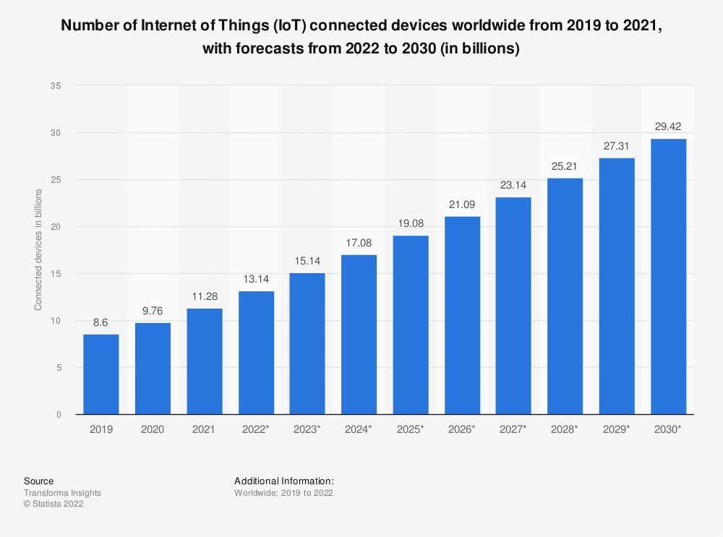
Boom of IoT Services
IoT is having a significant impact on sectors such as healthcare, transportation, agriculture, energy, and entertainment.
In 2019, IoT market was worth $465 billion, expected to reach $1.5 trillion by 2030.
As more and more smart devices connect to the Internet, it will be harder to pick the right IoT services for a specific task

Slide 18
How to address the issue?
Function-based service recommendation was introduced which recommends services by analyzing the functional similarities between services and user preferences.
However, these approaches mainly take into account functional properties and do not consider the contextual features of IoT environments or the heavy dependence on preference descriptions.
To overcome these limitations, a novel context-aware IoT service recommendation approach called DFORM is proposed.
It combines deep neural networks and collaborative filtering to learn the complex interactions between users and services, and recommendation results.
Notes:
D-FORM stands for "Dynamic Feature-based Online Reputation Model" and it is a context-aware service recommendation approach that considers both the dynamic features of services and the online reputation of service providers. D-FORM uses a Bayesian network to model the relationships between the dynamic features of services and the online reputation of service providers, and it recommends services based on user preferences and context information. D-FORM aims to improve the accuracy and reliability of service recommendations in dynamic and uncertain environments, such as IoT.

Slide 19
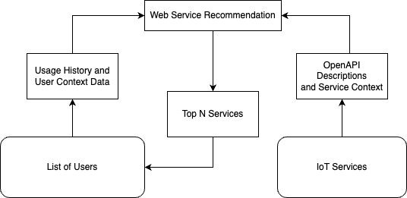
Context-aware IoT service recommendation

Slide 20
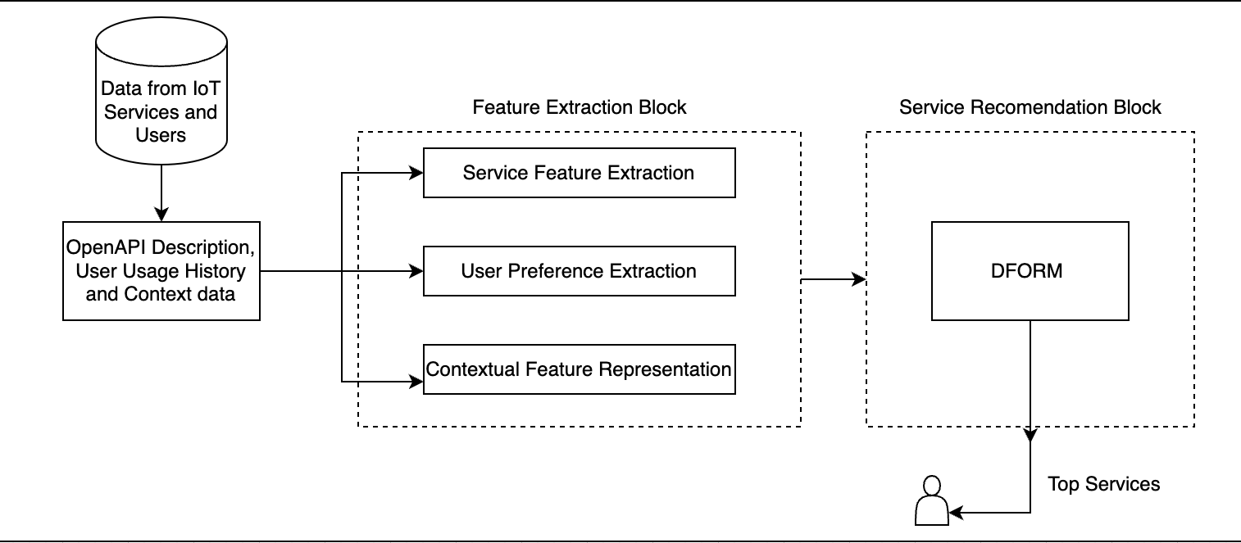
Overview of DFORM
DFORM models the relationships between the dynamic features of services, and it recommends services based on user preferences and context information.
The approach consists of two major components:
1. Feature Extraction
2. Service Recommendation.

Slide 21
Feature Extraction
Feature Extraction extracts functional and contextual features from multi-source data such as OpenAPI descriptions, user usage history, and location, etc.
Functional features of services are extracted from OpenAPI descriptions.
Functional preferences of users are derived by combining historical preferences extracted from usage history and potential preferences extracted from similar users.

Slide 22
Service Recommendation
Provides a recommendation model that uses deep neural networks and collaborative filtering to capture interactions between users and services from the extracted features.
The model predicts interaction probabilities between users and services and recommends top-N ranked services to the user.

Slide 23
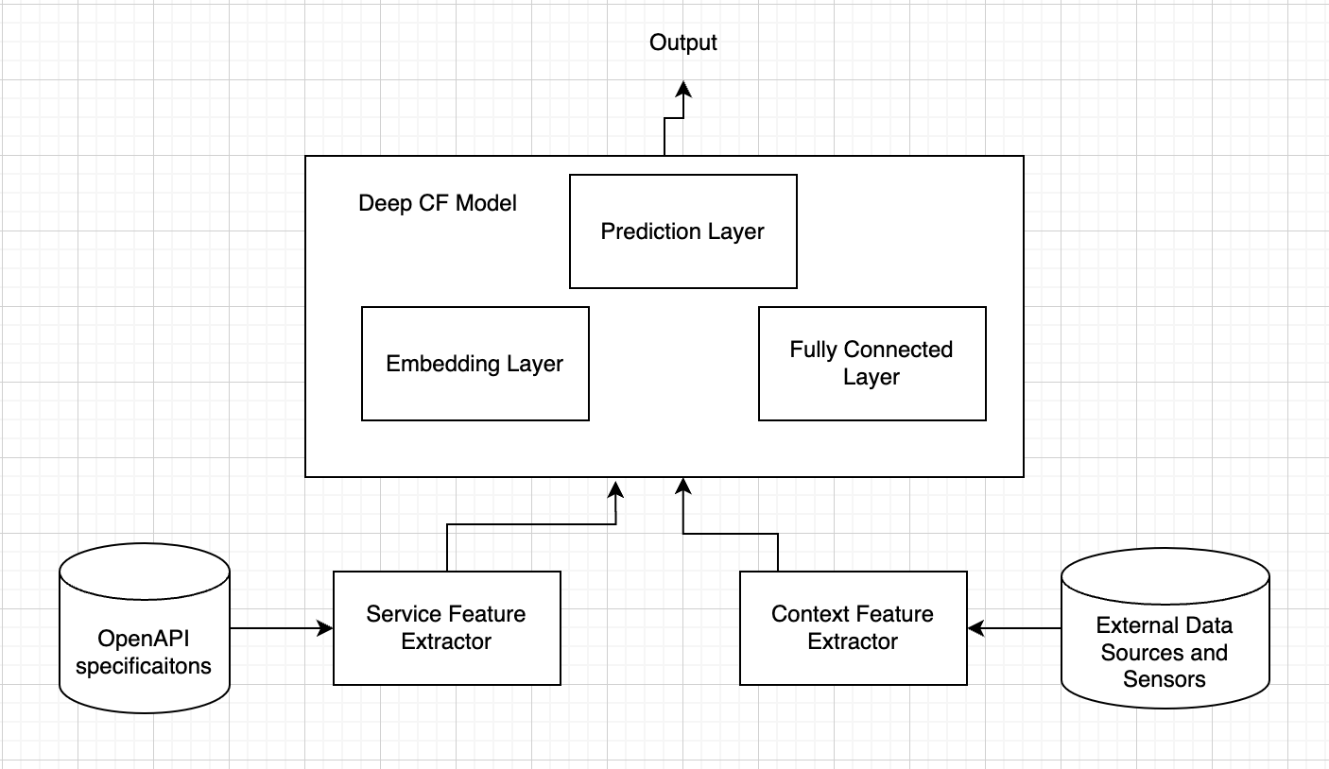
Architecture of Recommendation model
Consists of three main components: a service feature extractor, a context feature extractor, and a deep CF model.
The service feature extractor uses OpenAPI specification files to extract service features such as input/output parameters, service tags, and descriptions.
The context feature extractor captures contextual features such as location, time, weather, and device status by using external data sources or sensors.
Both service and context features are then fed into the deep CF model to predict the user's rating for a particular service in a specific context.

Slide 24
Deep CF model
The deep CF model is composed of three layers:
The embedding layer maps the input features into a low-dimensional space to capture the features of the services and contexts.
The fully connected layer combines the features with nonlinear activation functions to learn the interactions between services and contexts.
The prediction layer outputs the predicted rating for a given service and recommends it to the users.

Slide 25
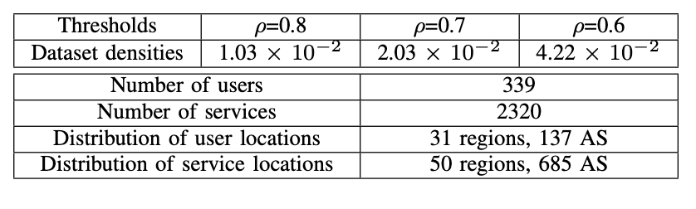
Evaluation Dataset
The evaluation is conducted on a real-world dataset consisting of IoT services and user preferences.

Slide 26
Evaluation Metrics and Baseline Technologies
Evaluation metrics, including precision, recall, F1 score.
Baseline Technologies against which DFORM is compared.
UCF recommends services based on similar users’ behavior information.
ICF recommends services based on similar services’ invocation information.
LACF incorporates locations of users and services into collaborative filtering for service recommendation.
PMF is a probabilistic matrix factorization service recommendation approach.
NCF combines deep learning and collaborative filtering for service recommendation.
ECAM is a context-aware deep learning service recommendation framework, from which two techniques were instanced, namely ECAM1 and ECAM2.

Slide 27
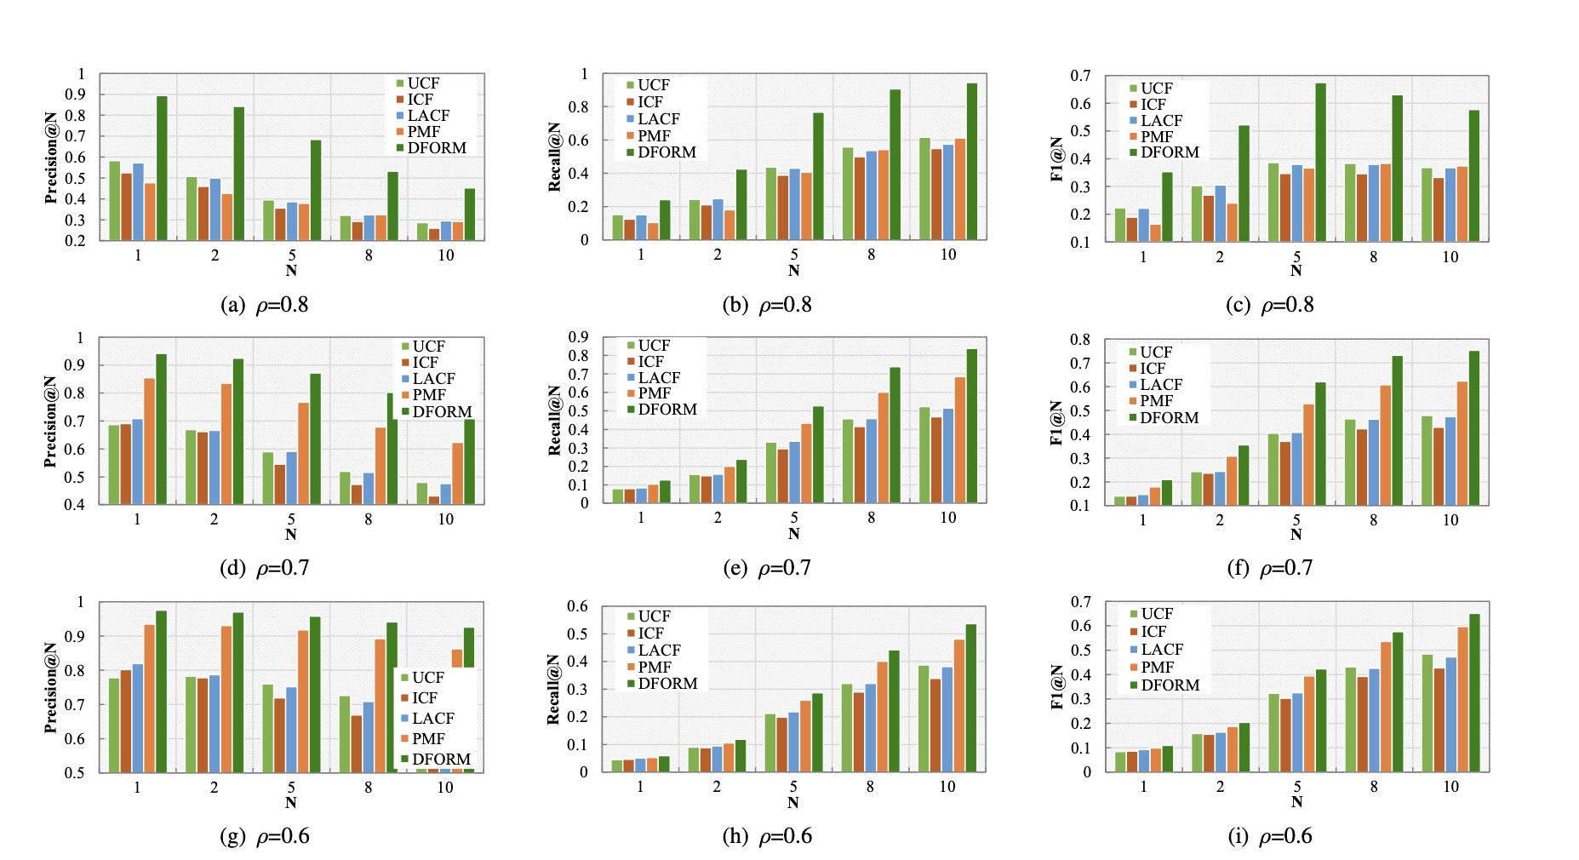
Evaluation Results

Slide 28
Location-Aware Feature Interaction Learning for Web Service Recommendation:
Motivation
Web services are widely adopted and there is a need for effective recommendations to select the optimal services from a large number of candidates. LAFIL takes into account the location details of user and service to recommend the best service.
The good performance of service-oriented systems depends on Quality-of-Service (QoS), yet getting unknown QoS values is difficult for a variety of reasons, including resource consumption and dependence on the environments of users and services.
Due to the scant real-world invocation records and lack of consideration for the cold-start problem when new users or services arise, the majority of QoS prediction methods have low prediction accuracy.

Slide 29
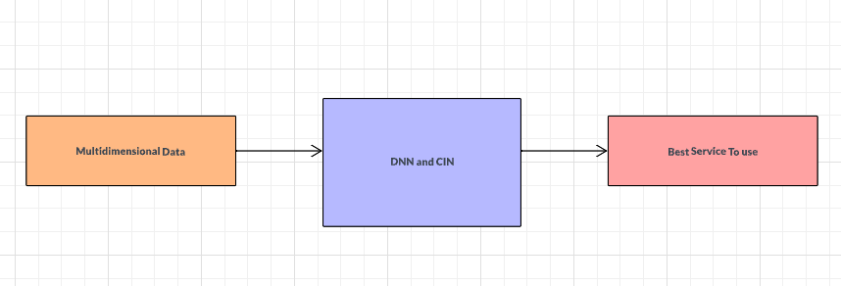
Approach
Overview of the three steps:
Location-aware Feature Transformation.
Feature Interaction Learning
Recommendation

Slide 30
Implementation
The implementation for the web service recommendation system extends the methodology of Location-Aware Feature Interaction Learning for Web Service Recommendation.
The implementation is done in four steps:
Collect and preprocess historical data.
Location aware feature transformation.
Feature Interaction Learning for prediction.
Recommendation.

Slide 31
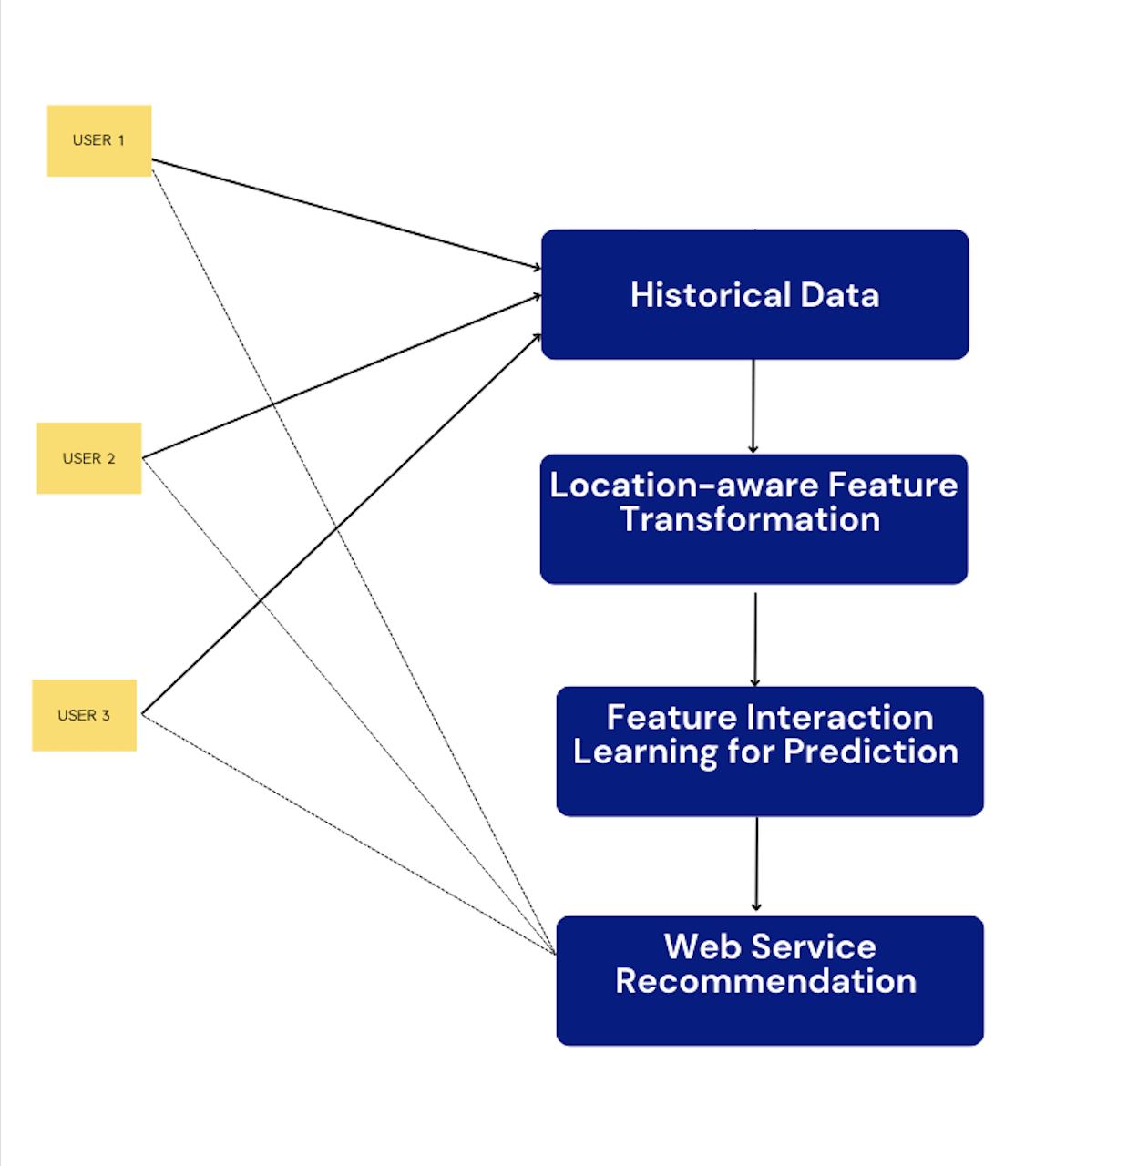
LAFIL Architecture

Slide 32
Implementation
Loading and preprocessing the data:
Reads data from the QoS dataset collected by Zheng et al.
Encodes categorical variables using sklearn LabelEncoder and adds a new label with QoS values as runtime of each service.
Returns a pre-processed dataframe.

Slide 33
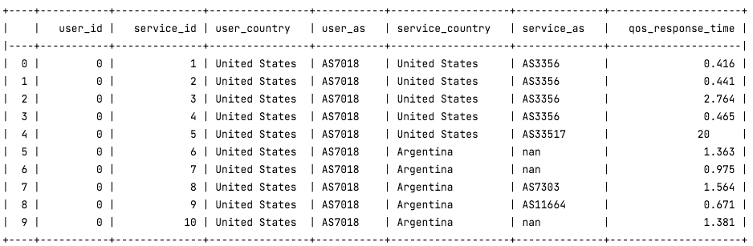
Multidimensional data to start with:
A small sample of 30,287,610 rows

Slide 34
Implementation
Feature Interaction Learning:
Performs one-hot encoding on categorical fields and compresses them using corresponding embedding layers
Defines the Deep Neural Network (DNN) and Compressed Interaction Network (CIN) architectures using TensorFlow.
Trains a combined model on the embedded features as input.
Evaluates the model's performance using Root Mean Squared Error (RMSE) and Mean Absolute Error (MAE) and predicts quality of service (qos) for test data.

Slide 35
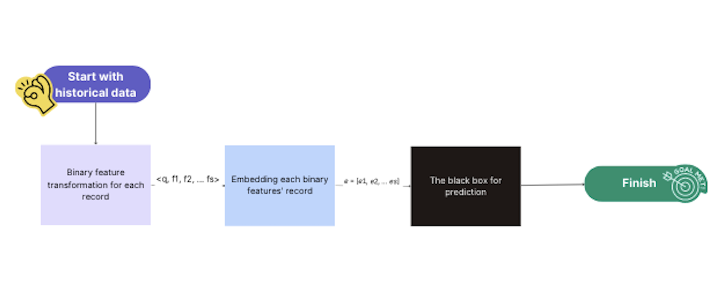
Workflow

Slide 36
Neural Network Architecture:
CIN:
Data with a specific input dimension are received by the input layer.
The input features are converted into low-dimensional embeddings using a dense layer with ReLU activation.
Iteratively, a number of hidden layers are constructed, each one made up of a number of feature maps that are concatenated to produce interactions.
Binary predictions are produced via a dense layer with sigmoid activation in the output layer.

Slide 37
Neural Network Architecture:
DNN:
Three layers make up the DNN.
The first layer has 128 neurons with the ReLU activation function.
The second layer has 64 neurons.
The number of neurons in the output layer is 1.

Slide 38
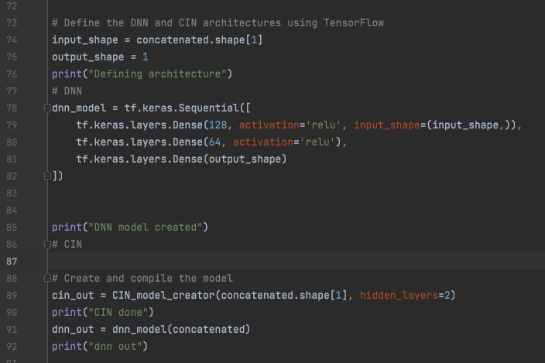
DNN and CIN

Slide 39
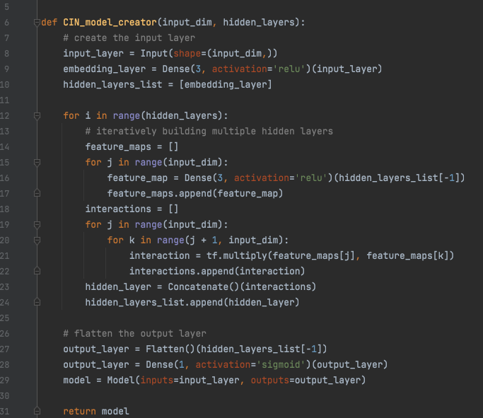
Behind the scene CIN

Slide 40
Implementation
Recommendation
Accepts the 'top k' argument to choose the number of top services.
Loads the data from pickle file .
The top k services with the lowest expected QoS values are chosen.
Prints the selected services.

Slide 41
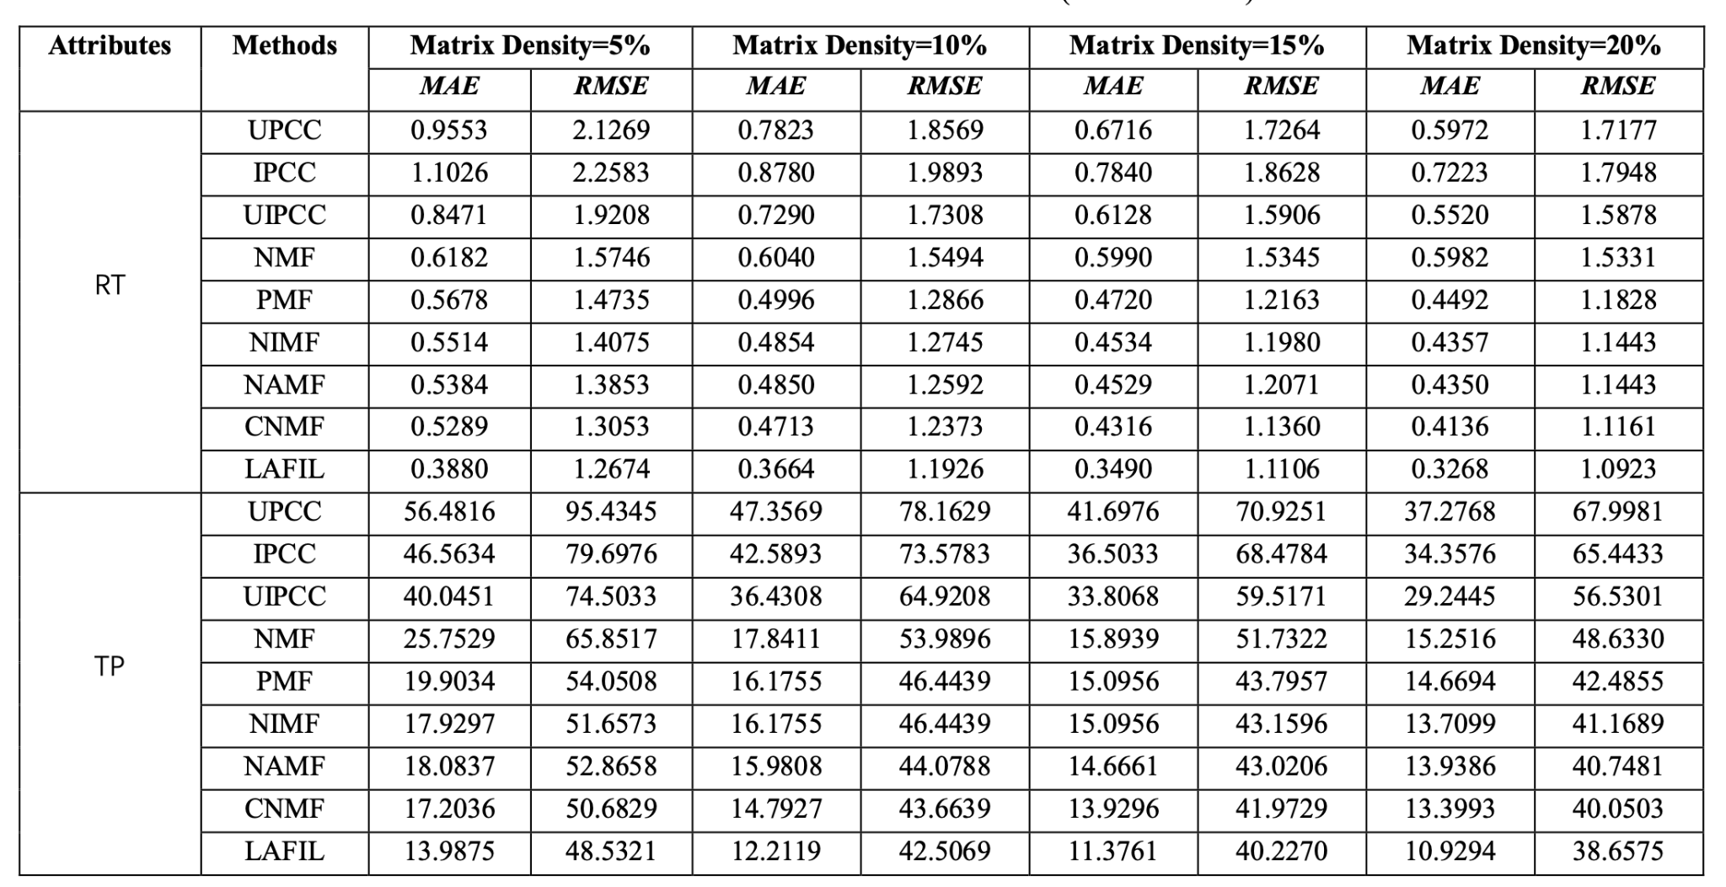
Evaluation
After running the code for little over 28 hours we were able to achieve a MAE and RMSE score of 0.4221 and 1.3365 respectively for a matrix density of 30%

Slide 42
Future Work with implementation
Get a better PC:
The current environment for the model to run seems insufficient.
Model Evaluation:
The model’s accuracy can be improved by training the model on a larger dataset. Refining the model’s accuracy in future would involve running and training the model on a system with higher specs.
Optimization:
The run time could be improved by introducing pyspark instead of pandas.
The data could be divided into chunks and can be processed using threads.

Slide 43
Potential scope of improvement in the given paper
We could potentially evaluate/compute the QoS value using the given data. This saves the expense of mining the data along with a QoS attribute.
We could potentially eliminate a few location dimensions from the given data to reduce the cost of computation. We could possibly do this using methods like PCA to identify Principal Components of the given data.

Slide 44
Conclusion
A web service recommendation system is created that uses non functional features to recommend best services.
The project achieves it results in three steps.
The feature interaction learning component uses DNN and CIN to predict missing QoS values.
Considering that the web services used as input in the test data are of different origin,the best web service is recommended by sorting the QoS values and returning the web services with hughes QoS values.

Slide 45
Thank you !

